Slide 1
Order-Kraft
Next-Gen Order Management System
for Manufacturing Efficiency

Slide 2
Squad – 3 Team Members:
Tejaswini Lokesh Sai Vivek Rahamthulla Yogeshwaran

Slide 3




TechStack
Application | Software Used | Version
Frontend | Angular (VS Code) | 20.1.3
Backend | JDK | 17
 | Spring Tool Suite (STS) | 3.2
Database | Oracle | 11
Testing | Soap UI | 5.9.0

Slide 4
Project Overview
OrderKraft is an integrated procurement and order management platform designed to help businesses streamline operations, reduce manual effort, and gain visibility across their supply chain.
It addresses common procurement challenges by:
Automating repetitive workflows
Enabling real-time tracking of orders
Providing data-driven decision-making tools through intelligent dashboards
Preventing stock shortages and overstock situations.

Slide 5
User Roles in OrderKraft
Admin: Controls user roles, system setup, and accesses all reports.
Supplier: Provides materials, updates delivery status, and is evaluated on performance.
Procurement Officer: Creates purchase orders, tracks order status, manages suppliers and payments.
Inventory Manager: Manages stock levels, receives alerts, and generates inventory reports.
Production Manager: Plans and tracks production tasks, ensures deadlines are met.

Slide 6
Key Features
Order Management – Create, update, and track orders seamlessly for efficient operations.
Inventory Tracking – Monitor stock in real time with alerts to prevent shortages or excess.
Supplier Management – Manage suppliers, track performance, and handle contracts.
Production Scheduling – Plan and oversee production tasks to meet deadlines.
Shipping Integration – Connect with delivery partners for faster, streamlined tracking.
Reports & Dashboards – Access interactive reports for actionable insights and performance tracking.
Role-Based Access – Secure data by providing role-specific access to users.

Slide 7
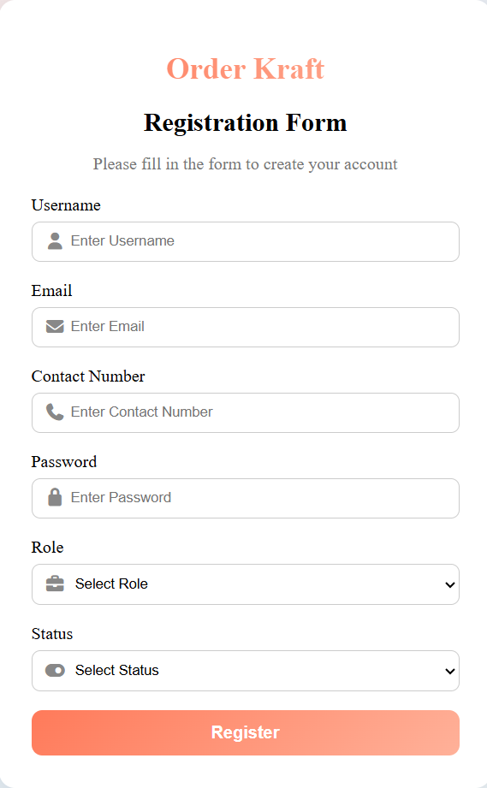
1.1Registration
Use Case 1: User Authentication and Role Management
Purpose:
To ensure secure user onboarding, manage login credentials, assign roles, and control access to different system functionalities.
Admin Registration – Adds new users (Admin, Inventory Managers, Procurement Officers, Suppliers, Production Managers).
Role Assignment – Defines and assigns roles to set user permissions.
Email Verification – Sends verification email to confirm identity and activate account.

Slide 8
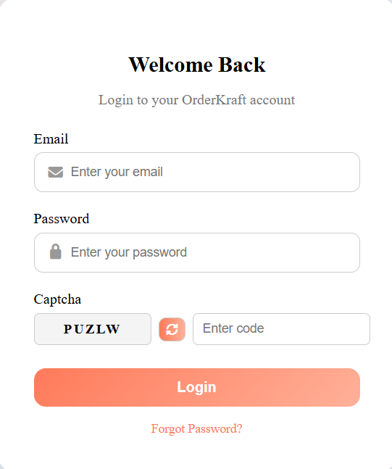
1.2 Secure Login
Login – Users log in with username and password.
Session Management – Backend creates and manages sessions for secure, continuous access.

Slide 9
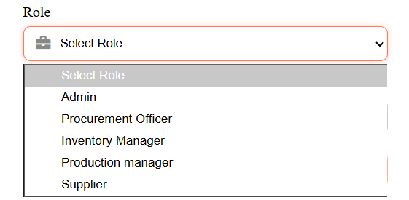
1.3 Role Assignment
Role Assignment – Admin assigns and updates
user roles as needed.
Automatic Permissions – System applies permissions
based on assigned role.
Action Flow – Admin selects role, system applies
permissions, and changes update instantly.

Slide 10
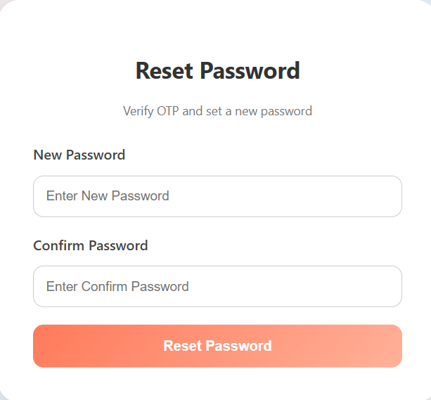
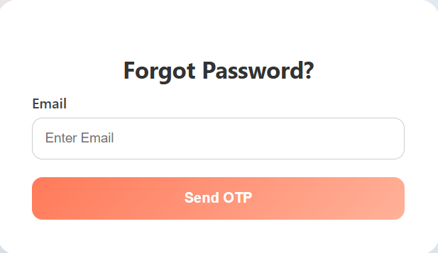
1.4 Password Reset
Users can select the "Forgot Password" option to reset their password.
A one-time password (OTP) is sent to the user’s registered email for verification.
After verifying the OTP, users can create a new password.
The new password must follow the system’s security policy.

Slide 11
1.5 Password Policy Enforcement
Minimum 8 characters, at least 1 uppercase & 1 number.
Real-time validation feedback during input.
Prevents reuse of old passwords.
Configurable rules for future updates.

Slide 12
1.6 Account Lockout
The account is locked after 5 incorrect login attempts.
The user receives an email alert when their account is locked.
The Admin can unlock the account manually, or it can unlock automatically after a set cooldown period.
1.7 Session Timeout
Users are automatically logged out after 15 minutes of no activity.
Session data is cleared to keep accounts secure.
A warning message appears before the logout happens.
This feature works for all user roles.

Slide 13
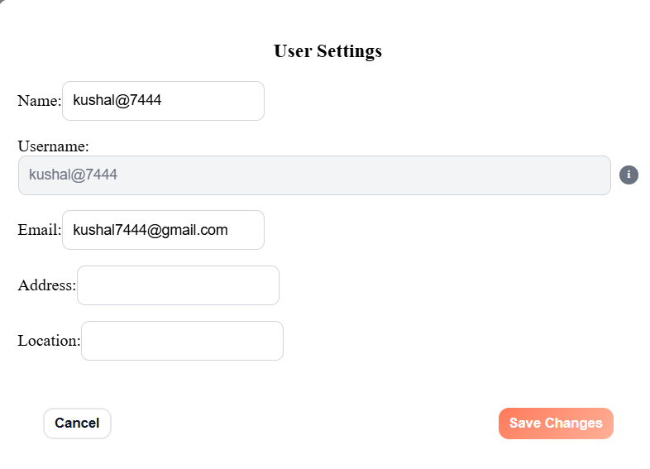
1.8 User Profile Update
Users can edit personal information like phone number and address.
All changes are checked for accuracy before saving.
Sensitive changes, like updating an email address, may need verification.
The system keeps a record of all profile updates.

Slide 14
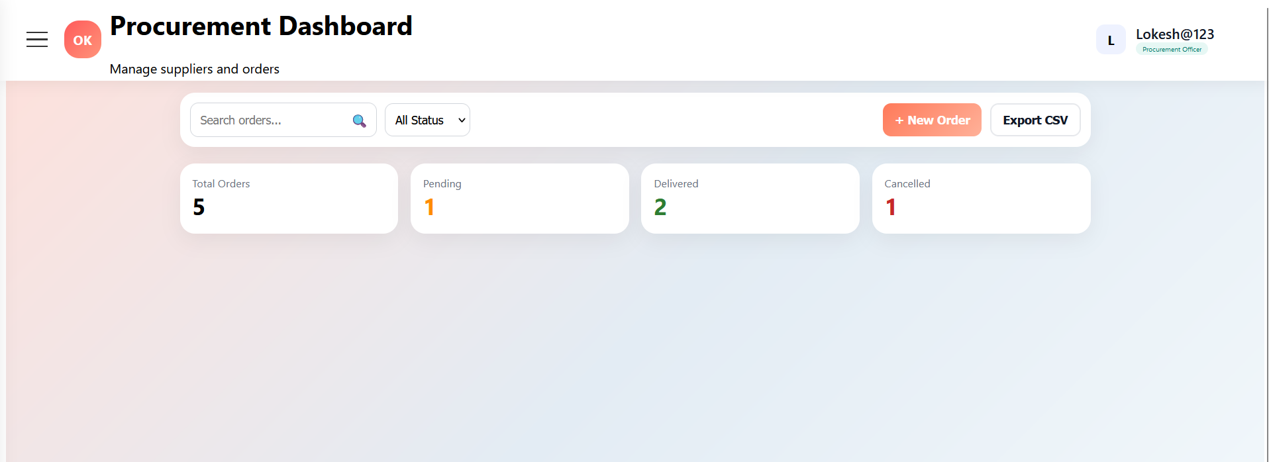
Purpose: To help users, especially Procurement Officers, easily create, update, track, and cancel orders for smooth and efficient order processing.
Use Case 2: Order Creation and Management
Procurement Officer Dashboard

Slide 15
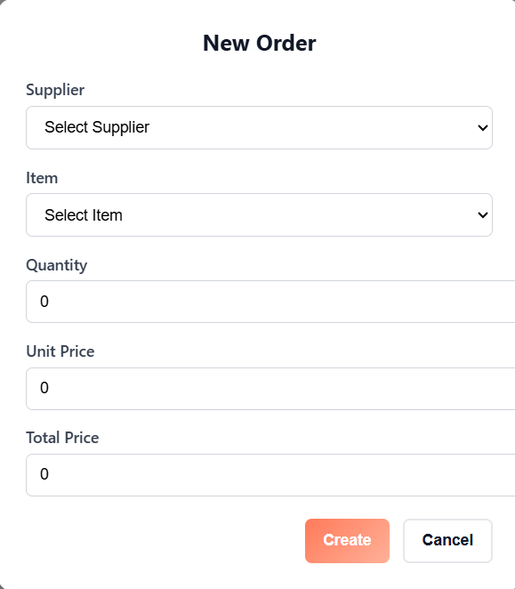
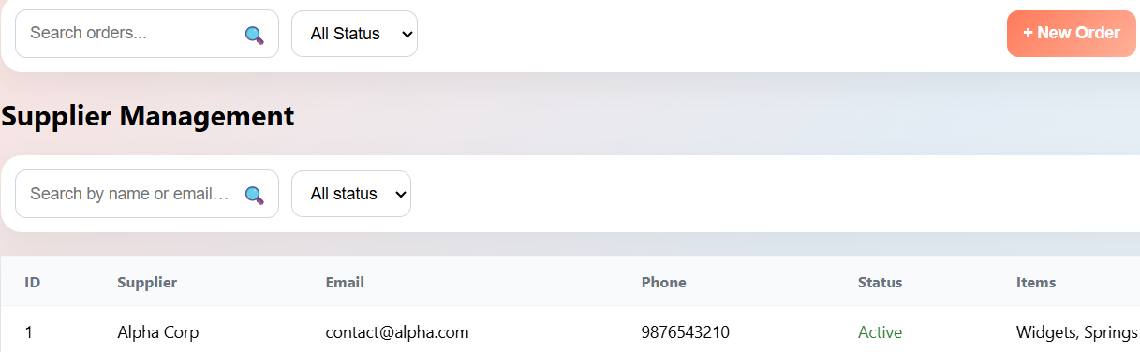
1.1 Create Order
Procurement Officer enters item and supplier information.
System validates the details and saves the order.

Slide 16
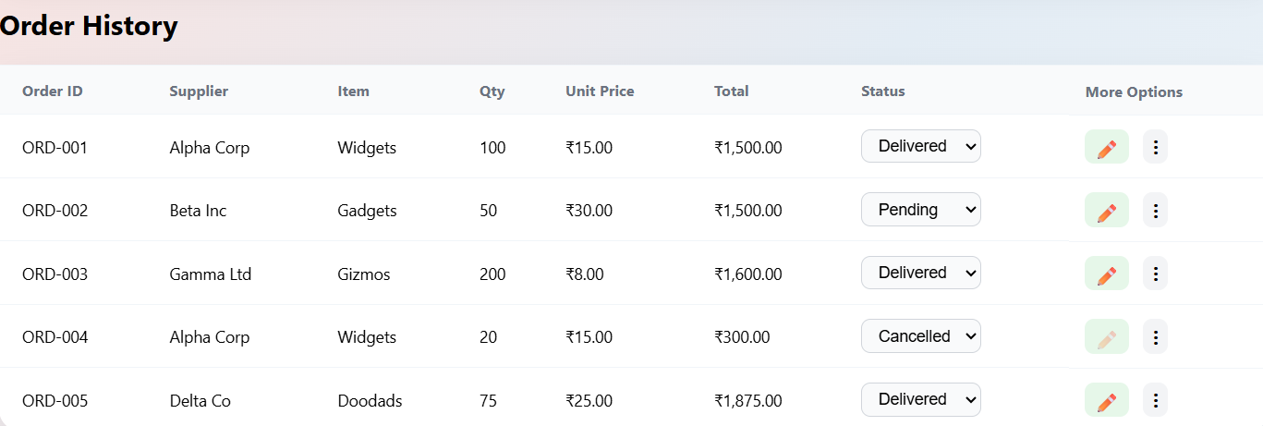
1.2 View Order History
Users can see previous orders and filter them by date, status, or supplier.
Helps users quickly find and track past orders.

Slide 17
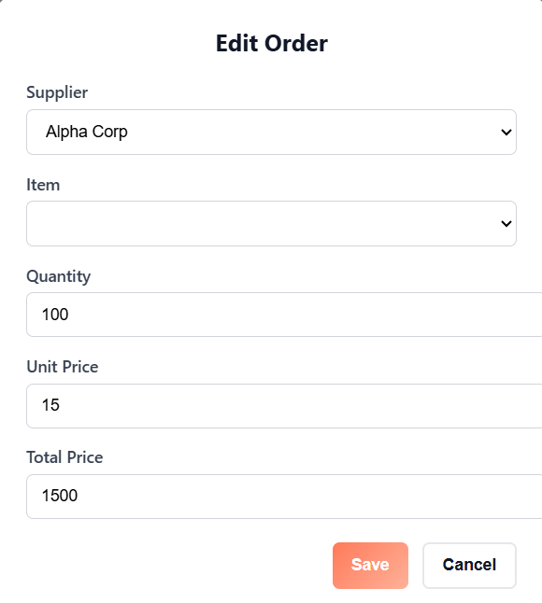
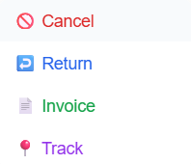
1.3 Update Order Details
Users can change the quantity, delivery date, or other order details.
The system checks the updates and saves them.

Slide 18
1.4 Track Order Status
Suppliers or systems send real-time order updates.
Users can check the current status and expected delivery time.

Slide 19
1.5 Cancel Order
Users can cancel orders that are no longer required.
The system changes the order status and sends notifications to stakeholders.

Slide 20
1.6 Order Payment Integration
The system connects to a payment gateway to handle payments.
Order status is updated based on whether the payment succeeds or fails.

Slide 21
1.7 Invoice Generation
Admin can generate invoices for completed and paid orders.
Invoices can be downloaded or printed as needed.

Slide 22
1.8 Return Order
Customers can request a return for defective items.
The system updates inventory and changes the order status.

Slide 23
THANK - YOU

